Slide 1
Astrodynamics Software Crash Course
Week 1: Course Introduction & GMAT Basics

Slide 2





About Me
Layne Droppers
Senior in Aerospace Engineering
Extensive Industry Experience:
Spirit AeroSystems | Stress Analysis, Boeing 737
Orbital ATK | Missile Warhead & Fuzing Engineer
NASA Langley Research Center | Interplanetary Propulsion Analyst
OneWeb | Flight Dynamics Analyst

Slide 3
Course Overview
Introduction to basics of astrodynamics software
What to expect within industry
GMAT training
STK training
By the end of the course, you will have the ability to perform astrodynamics analyses in both GMAT and STK, as well as have the skills needed to obtain your Level 1 STK Certification.

Slide 4
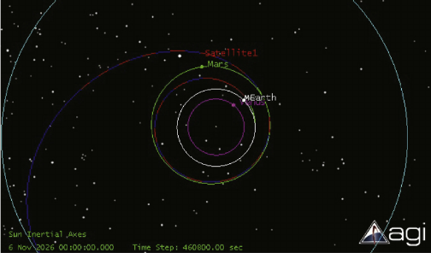
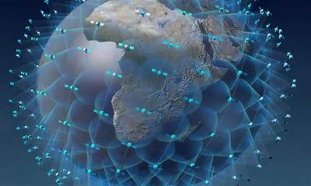
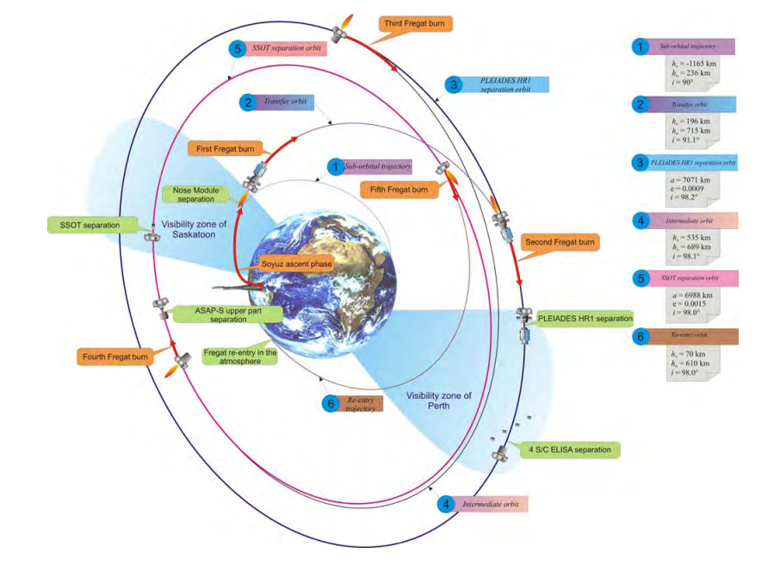
Astrodynamics in Industry
Interplanetary Trajectory Design [1]
Earth Satellite Deployment and Management [2]
Launch Vehicle Trajectory Design [3]

Slide 5
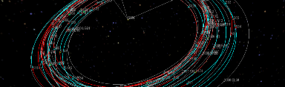
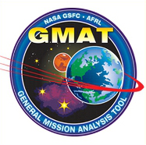
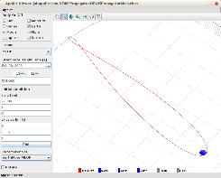
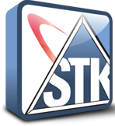

Astrodynamics Software
Copernicus (NASA, Govt. Employees & Contractors Only)
General Mission Analysis Tool (NASA, Free)
Java Astrodynamics Toolkit (SourceForge, Free)
Free Flyer (a.i. solutions, Commercial)
Systems Tool Kit (AGI, Pro for Astrogator)

Slide 6
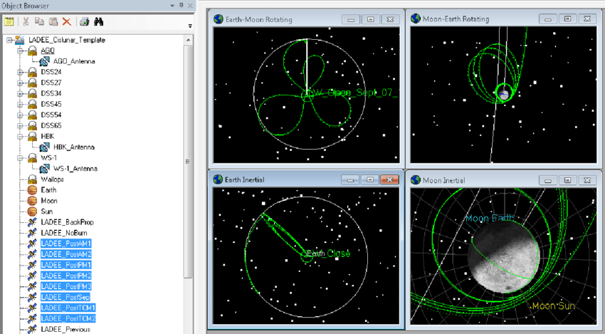
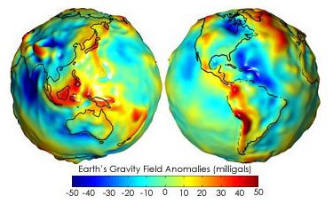
Why use Software?
Sophisticated spherical harmonic Earth gravity model
High-fidelity n-body gravity modeling
Earth, Moon, Sun, etc. without using patched-conics
Ability to accurately model orbit perturbations
Atmospheric drag
Solar radiation pressure

Slide 7
Potential Use Cases
Optimizing an analysis
Launch date determination
Minimizing propellant needed
Minimizing duration of task
Determining propellant needed for mission maneuvers
Satellite acquisition of signal (AOS) and loss of signal (LOS) with a ground station.
Satellite pointing requirements (attitude) over time

Slide 8
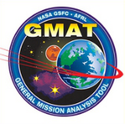
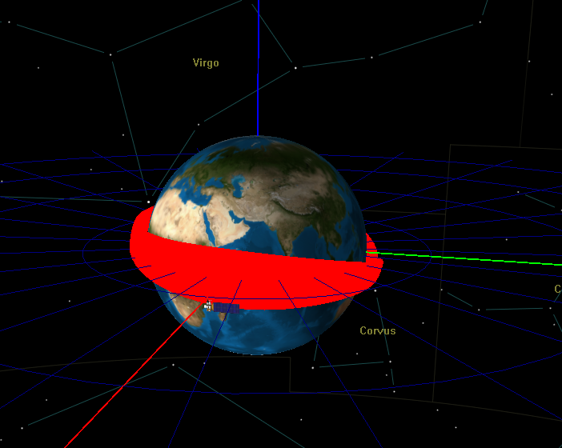
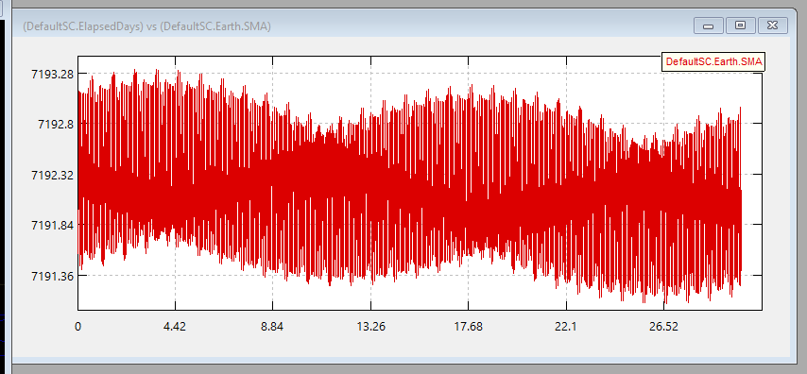
GMAT
General Mission Analysis Tool (GMAT) is the most common open-source software used for flight dynamics
Developed by NASA Goddard Space Flight Center
Supports constrained and unconstrained trajectory optimization
Basic capabilities include:
Plotting trajectories in space
Plotting parameters against one another
Saving parameters to reports for later reference

Slide 9
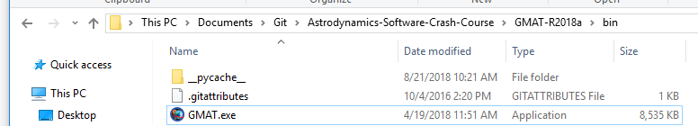
Opening GMAT
If you haven’t already, download the course folder from https://github.com/laynedroppers/Astrodynamics-Software-Crash-Course
Wherever you save this folder, we will refer to it within the course as “…/Astro-Crash-Course”
To run GMAT, double-click on the GMAT executable at …/Astro-Crash-Course/GMAT-R2018a/bin/GMAT.exe

Slide 10
GMAT GUI

Slide 11
References
[1] Lynam, A.E., “Broad-search algorithms for the spacecraft trajectory design of Callisto-Ganmede-IO triple flyby sequences from 2024-2040, Part II: Lambert pathfinding and trajectory solutions,” Acta Astronautica, Vol. 94, 2014, pp. 253-261.
[2] de Selding, P. B., “One year after kickoff, OneWeb says its 700-satellite constellation is on schedule,” Spacenews [online], July 2016, https://spacenews.com/one-year-after-kickoff-oneweb-says-its-700-satellite-constellation-is-on-schedule/
[3] “Soyuz User’s Manual – Issue 2 Revision 0,” Arianespace, March 2012, http://www.arianespace.com/wp-content/uploads/2015/09/Soyuz-Users-Manual-March-2012.pdf

